Slide 1

Transit & Weather
Group Members:
Sara Manha - 3736450
Safia Naznin - 3762140
Rishabh Kalai - 3740704
Saeid Metvaei - 3765172

Slide 2

Motivation
Hotspot Transit and Weather App are two important apps we use daily.
Both these apps play a huge role in our everyday life.
We want to be able to optimize route and increase overall user satisfaction.

Slide 3
Data-Set Details
Data Source : Fredericton Open Data and Fredericton Weather Stats
Data Span: From 24-Nov-2019 to 31-Dec-2022
The data spans 3 years, 1 months and 8 days
Data Size: 58 Features and 220,000+ records
Tools Used: Python, Google Colab, Excel
Statistical and Machine Learning Techniques:
Correlation Analysis, Clustering and Numeric Prediction/Regression
Fredericton Transit Data:
https://datafredericton.opendata.arcgis.com/datasets/Fredericton::fredericton-transit-histories-2019- 2022/about 2. Data Download for Fredericton.
Fredericton Weather Stats:
https://fredericton.weatherstats.ca/download.html

Slide 4
Data Process Cycle
Data Preprocessing
Combining Data-sets from both sources - transit & weather
Cleaning Data: Imputing Missing Values with the relevant weekly data to maintain the seasonality/trends and not affect the distribution of the data
Data Normalizations: We converted the time values to 24 hour format
Data Enrichment: Assigning the Boarding Stop based on the boarding time and fredericton bus schedule

Slide 5
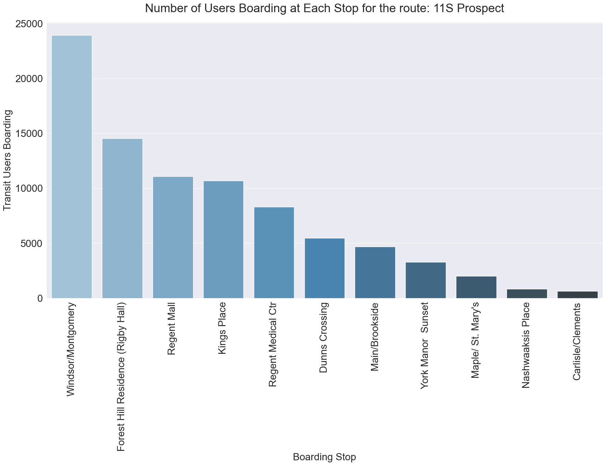
Distribution of Boardings at Bus-Stops

Slide 6
Feature Selection

Slide 7
Feature Selection and Initial Analysis
Feature Selection Methods:
Utilized the Gini Index Method and Correlation Analysis for feature selection.
Objective was to identify weather attributes impacting transit ridership.
Outcome:
Despite rigorous feature selection, no significant impact on transit ridership was observed.
Initial attempts to isolate influential factors proved inconclusive.

Slide 8
Unveiling Temporal Patterns: Weekdays vs. Saturdays
Temporal Analysis Approach:
Shifted focus to temporal patterns by comparing weekdays and Saturdays.
Expected to reveal variations in ridership behavior based on different days of the week.
Findings:
Unexpectedly, minimal variation in transit ridership between weekdays and Saturdays.
Majority of features exhibited consistent patterns throughout the week.
Noteworthy exception found in the impact of rain on transit ridership.

Slide 9
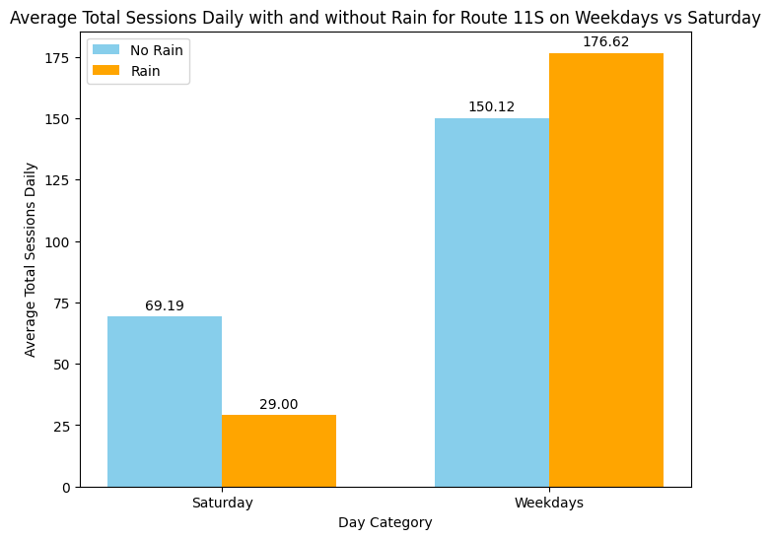
Rain Anomaly: Effect on Transit Ridership

Slide 10
Segmentation of Transit Users: Clustering

Slide 11
Motivation
Using clustering algorithms on transit user data, we hope to find specific usage patterns that will provide transit authorities with data-driven insights to optimize service offerings, improve resource utilization, and improve commuter experience.

Slide 12
Clustering Method Introduction: K-Means
K-means Algorithm:
Widely used for its simplicity and efficiency.
Groups data into clusters based on similar features.
Minimizes variance within clusters by refining assignments and centroids.
How it works?
Starts with random cluster centers (centroids).
Assigns data to the nearest centroid and updates centroids iteratively until they stabilize.

Slide 13
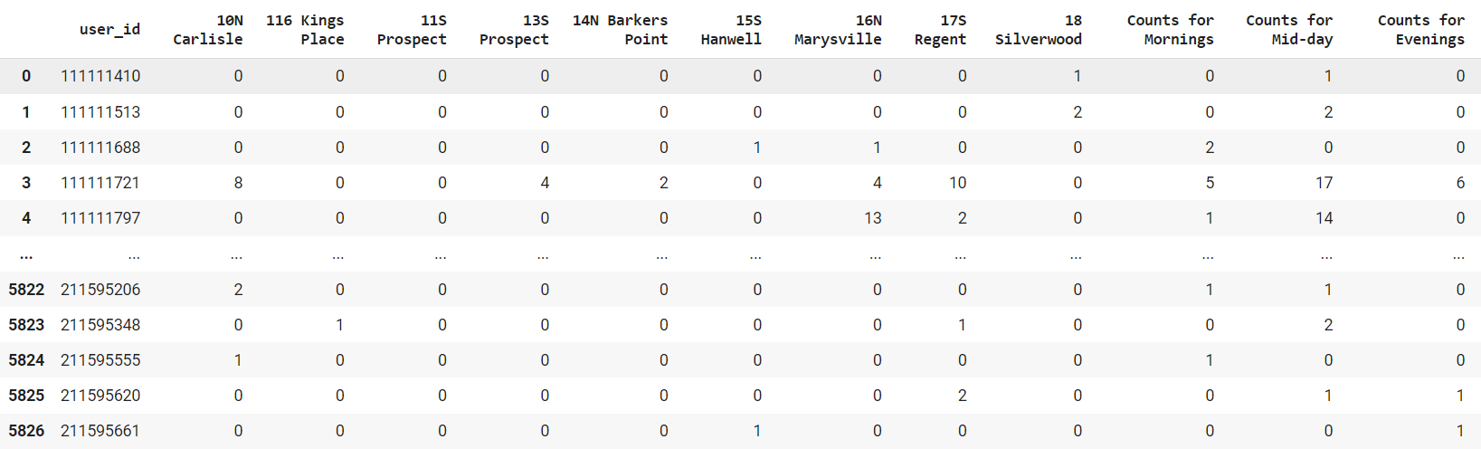
Methodology and Results of Clustering
Data preparation
  route usage
  daily time patterns

Slide 14
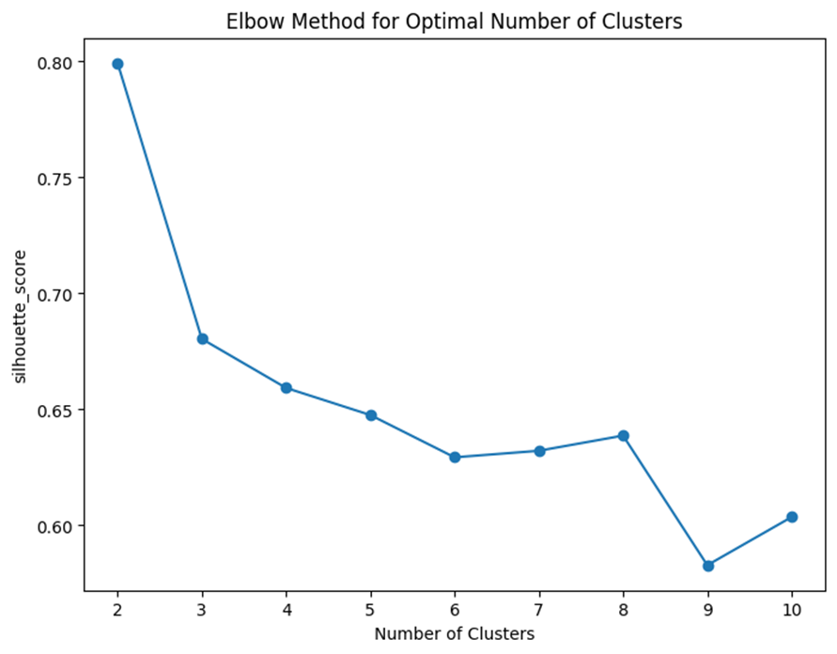
Methodology and Results of Clustering
Model Development
  Determining the best random state
  and the number of clusters

Slide 15
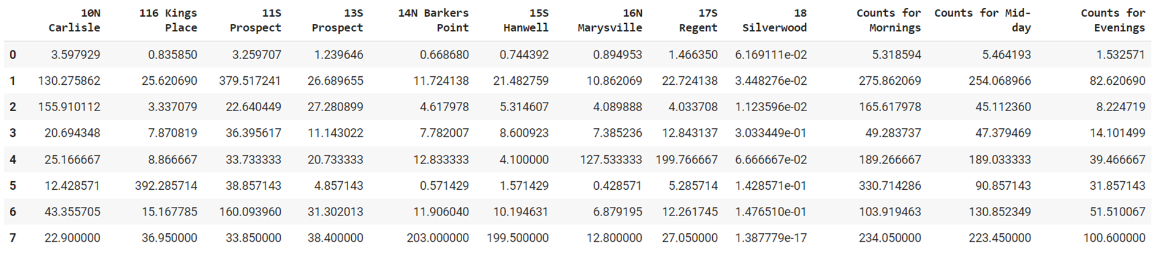
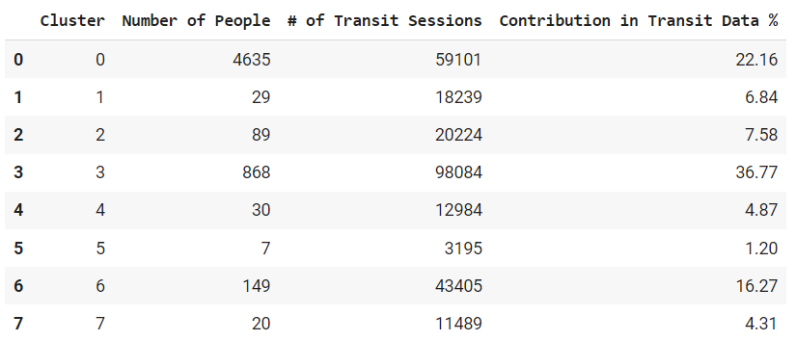
Methodology and Results of Clustering
Clustering Results

Slide 16
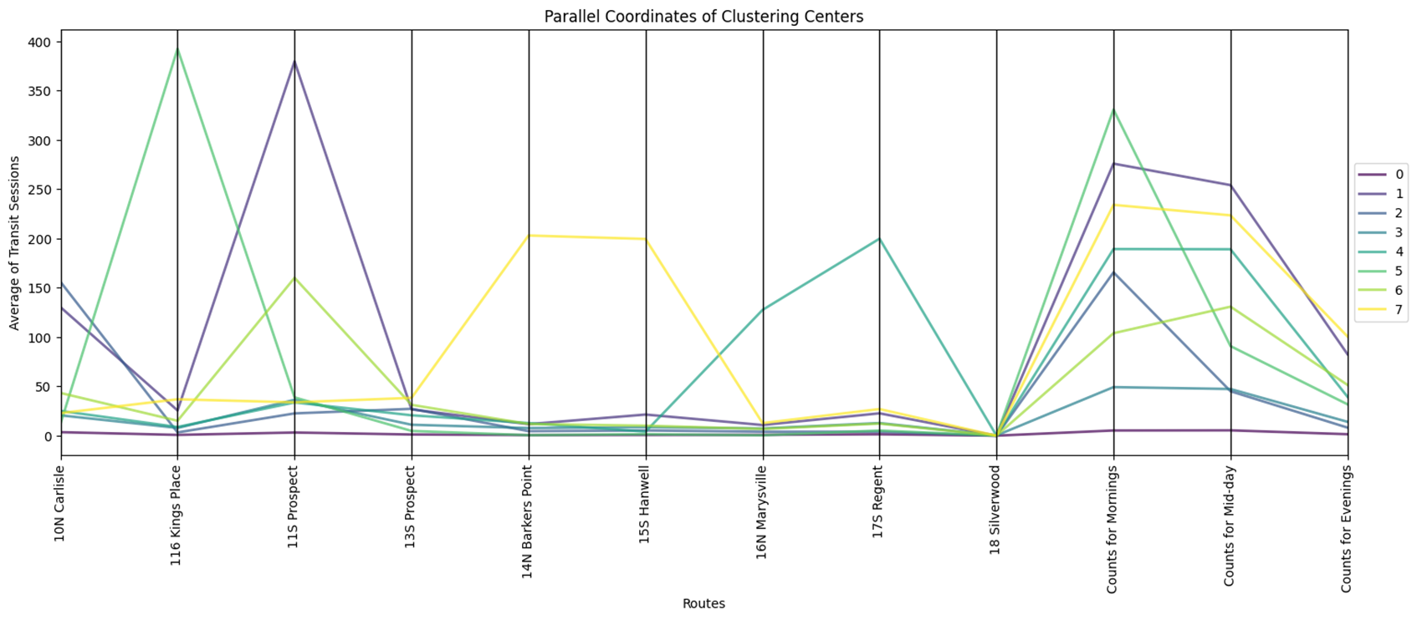
Methodology and Results of Clustering
Clustering Results

Slide 17
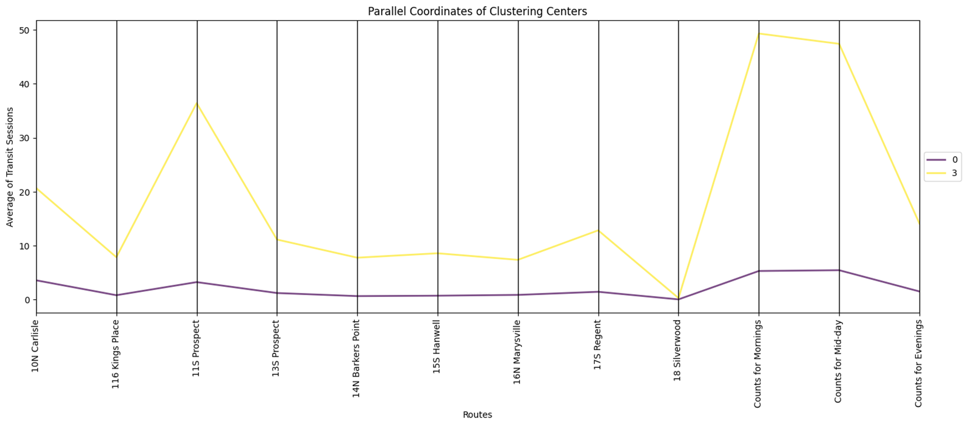
Methodology and Results of Clustering
Clustering Results

Slide 18
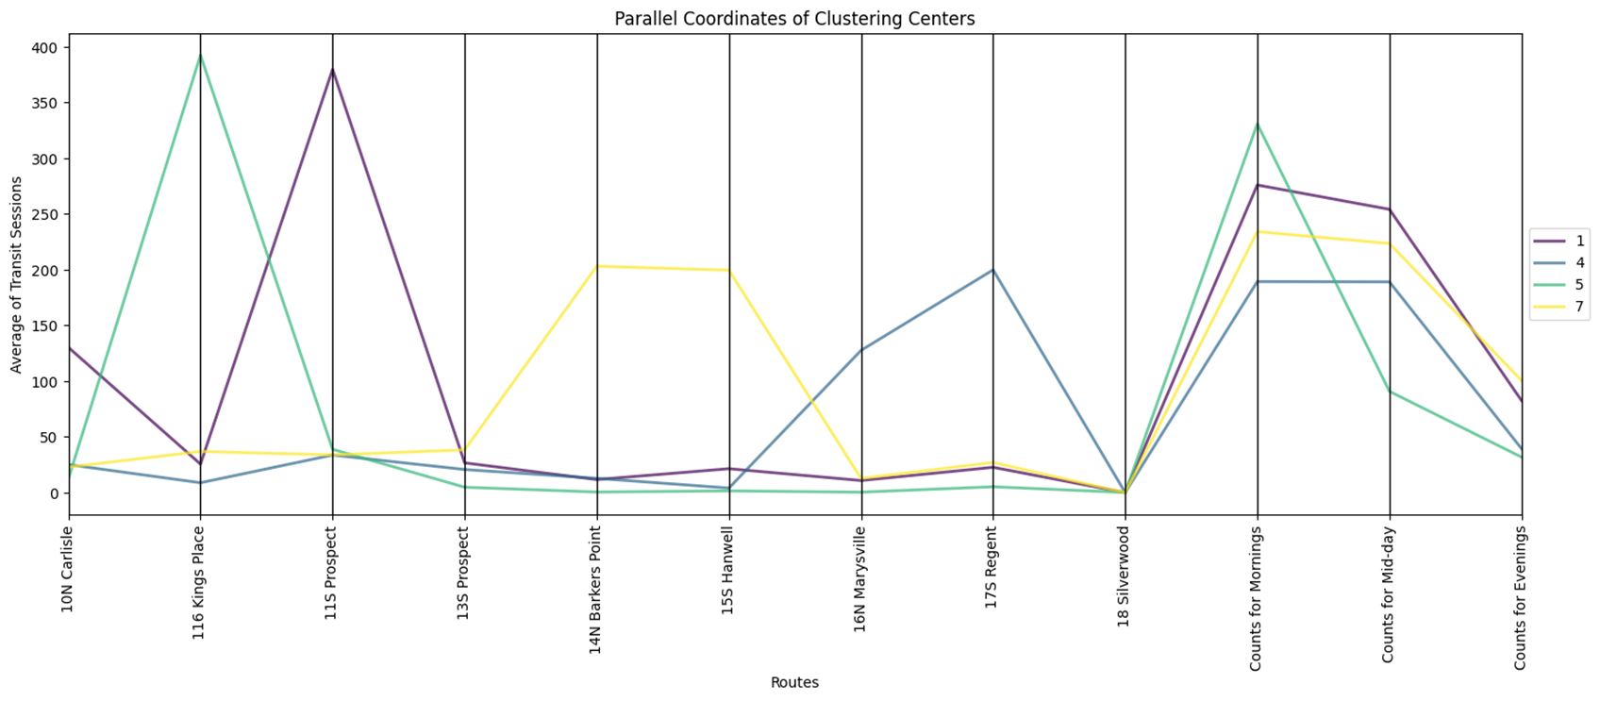
Methodology and Results of Clustering
Clustering Results

Slide 19
Application of the Clustering
Potential Benefits for Transit Authorities
Resource Allocation: Allocate resources such as buses and personnel efficiently based on high-demand routes and times.
Targeted Marketing: Design targeted marketing campaigns or promotions for specific user groups based on their travel patterns.
Infrastructure Planning: Plan new infrastructure or bus stops based on user clusters' preferences and frequent travel locations.
Service Planning: Identify popular routes and their peak usage times to optimize bus schedules and frequencies.

Slide 20
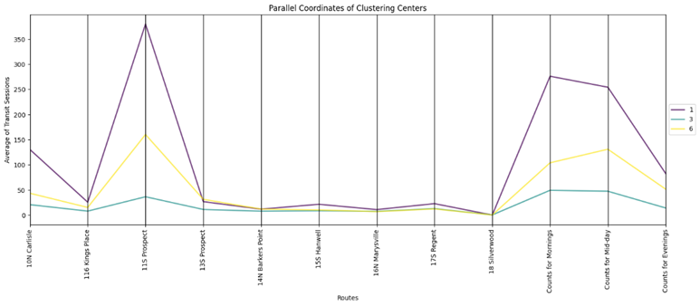
Application of the Clustering
Route Usage Analysis: Identifying primary route users in clusters informed dominant travel preferences

Slide 21
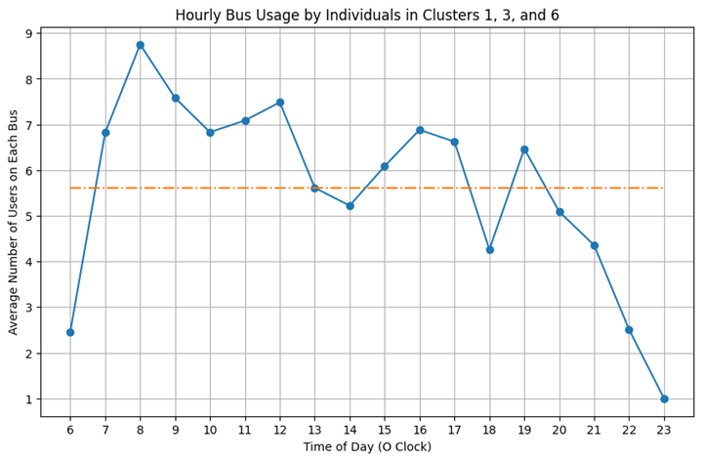
Application of the Clustering
Bus Usage Analysis:
Calculating average bus usage per route aids in defining peak hours throughout the year

Slide 22
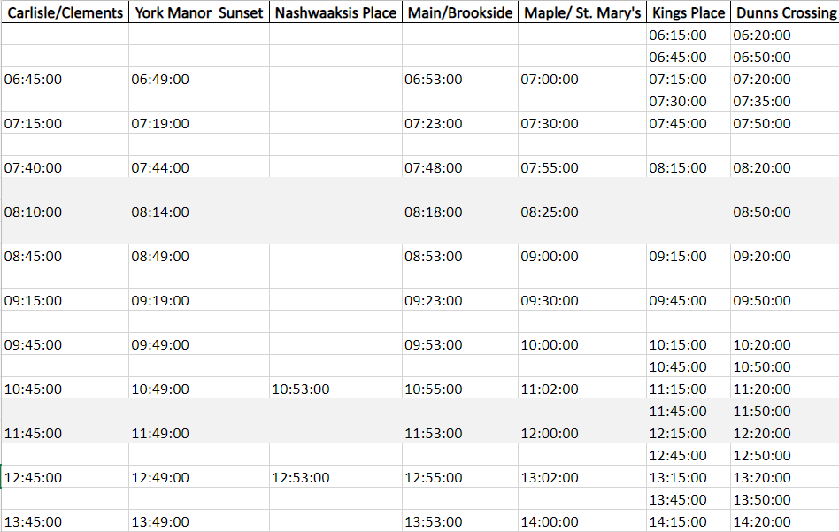
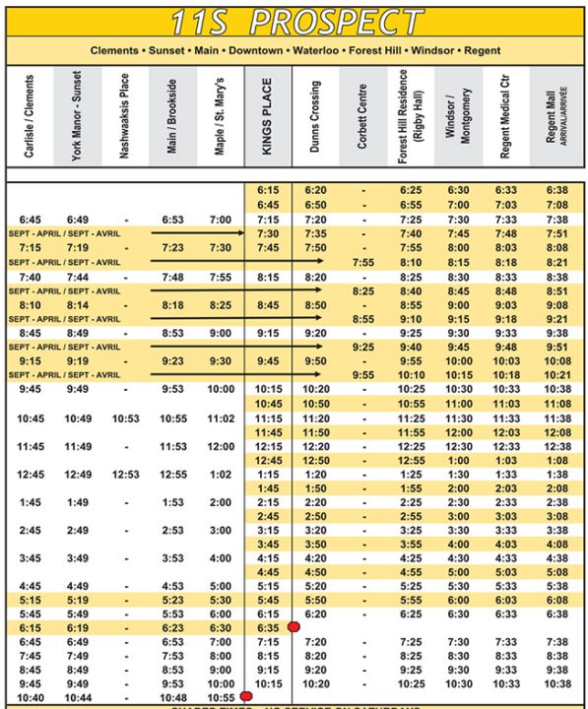
Application of the Results
Transit Authority Recommendations: These insights empower authorities to optimize bus schedules and enhance service quality for improved transit experiences

Slide 23
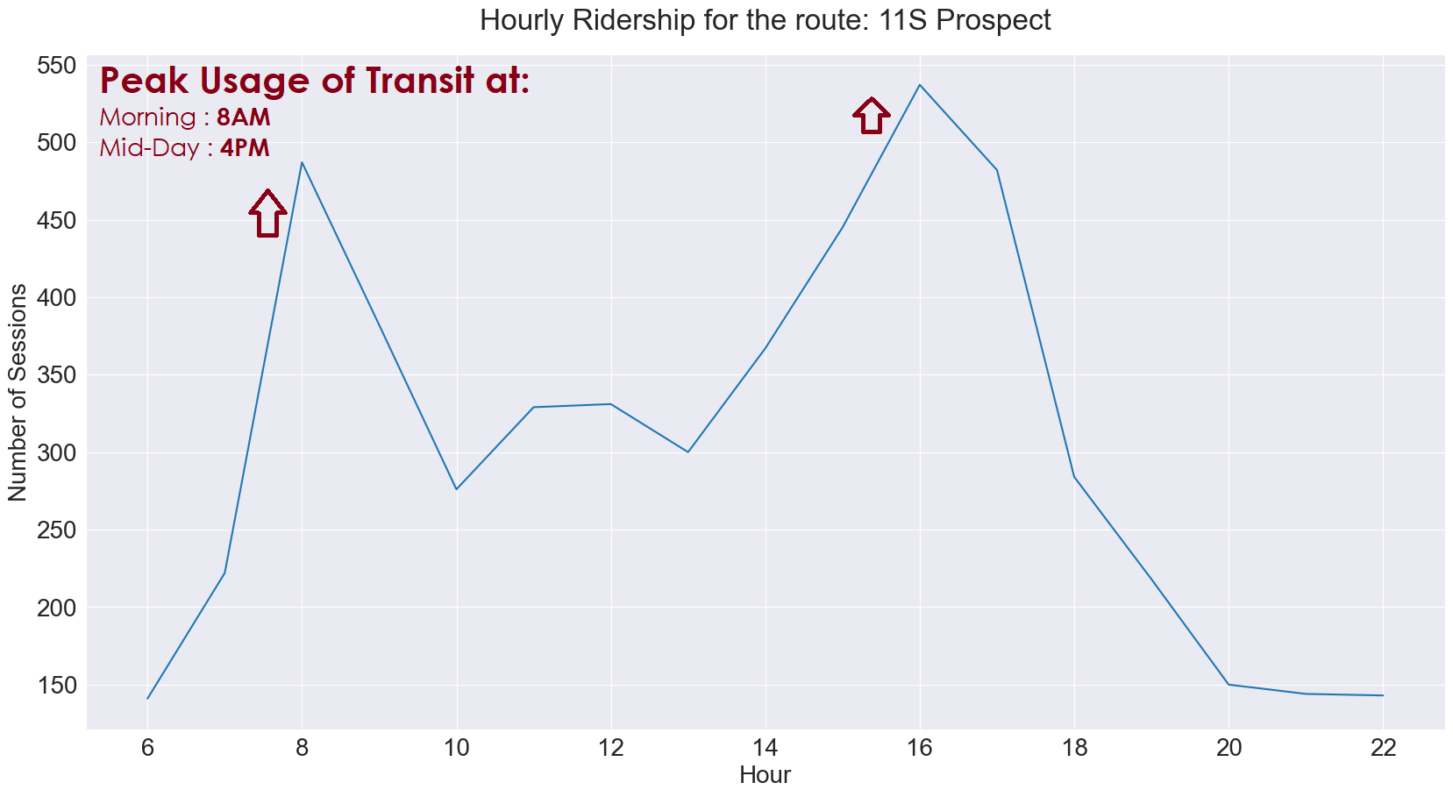
Hourly Ridership Trends: Weekday
Notes:
Strong Peaks at 8AM & 4PM.

Slide 24
Transit Usage Prediction: Regression

Slide 25
Why Predict Transit Usage?
Strategic Decision-Making Insights: Reveals key seasonal drivers for informed decisions on Transit Planning.
Transit Usage & Transit User Analysis provides a holistic view of the current transit system for Hotspot Users.
Seasonal-ARIMA model…

Slide 26
Why S-ARIMA? (Seasonal - AutoRegressive Integrated Moving Average)
Capturing Seasonal Trends:
  Ideal for weekly transit patterns and recurring seasonality.
Adaptability to Weekly Variations:
  Aligns with weekly variations influenced by weekdays and weekends.
Handling Anomalies:
  Robust to disruptions like COVID-19, smoothing short-term fluctuations.

Slide 27
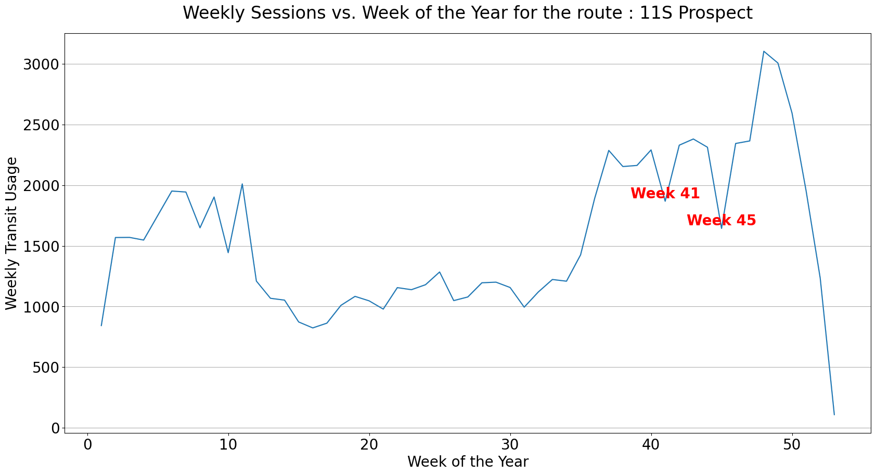
Weekly Transit Trends over the Year

Slide 28
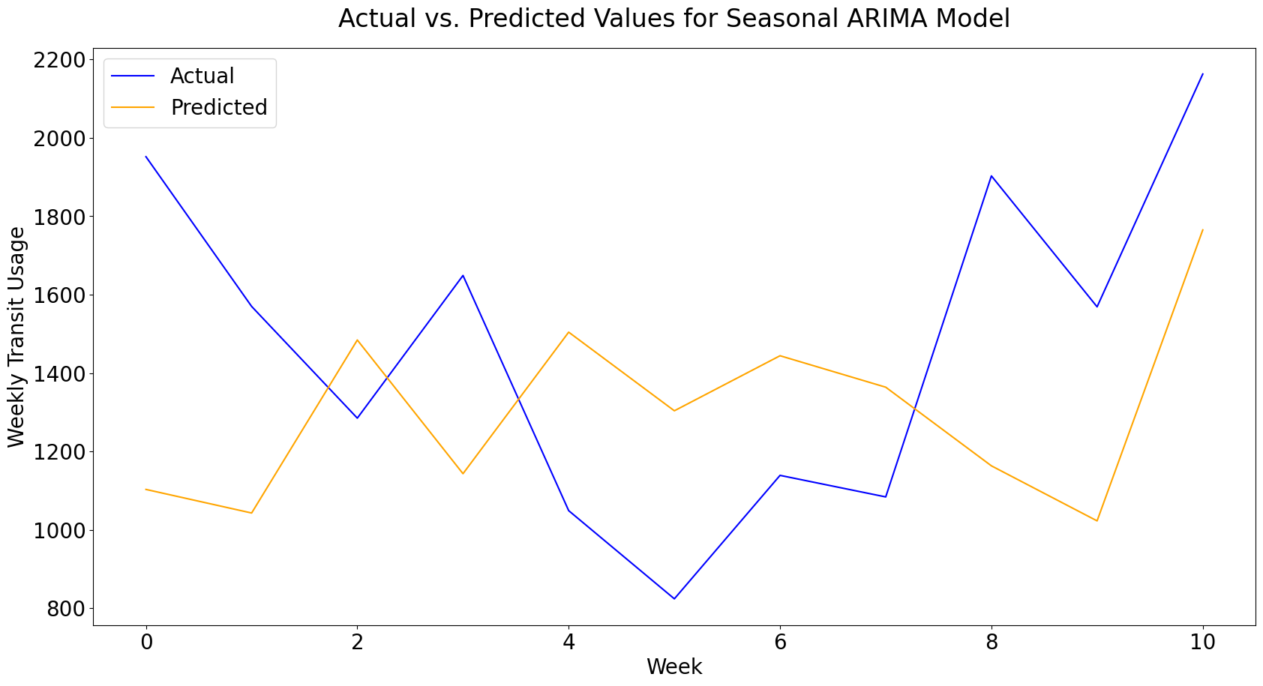
Seasonal-ARIMA Prediction
Best SARIMA model
RMSE: 507.9144 or
33.8% of mean
Notes:
In the context of transit operations, where daily alterations to bus schedules are impractical, the RMSE (Root Mean Square Error) of 33.8% and an accuracy of 66.2% are likely acceptable for optimizing weekly resource allocation.
It's crucial to prioritize capturing broader trends and weekly variations, which aligns well with the practical constraints of maintaining a consistent bus schedule.
While fine-tuning the model remains an option, the current performance metrics present valuable insights for optimizing transit resource allocation within the confines of a weekly planning cycle.

Slide 29
Limitations &
Future Enhancements

Slide 30
Limitations
Class Imbalance & Covid-Effect on Transit Ridership.
The Hotspot Transit Dataset is representative of just the transit users that happen to access the transit system of Fredericton using Hotspot App.
The Assignment of the Boarding Stops is an estimation and not much further analysis was done using it.
Caveats of the Hotspot App.
Future Enhancements
Using Boarding Stops, & Bus-Stops Description Dataset: provide further information of bus-occupancy rates & bus-stop structural efficiency.
Using transit patterns(& bus-stops), best possible location for new bus-depot/hub can be found.

Slide 31
Thank You!

